Slide 1
Introduction to Humanities Programming
Programming Concepts

Slide 2
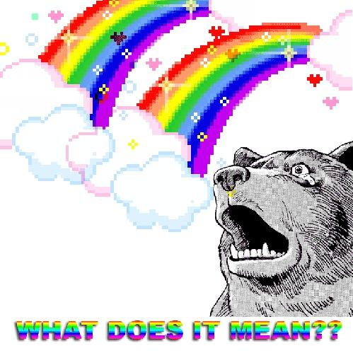
What does it mean?

Slide 3
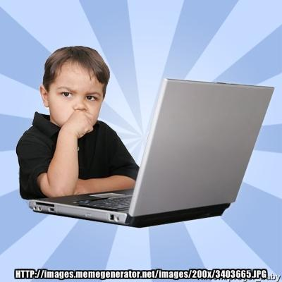
Why Program?
Applications come from the needs of the present: your needs
﻿Effectively articulating needs is the first step
Express complex logic and perform computation
Do things that would take a human a long time to do
counting
comparing
repeating

Slide 4
Digital Humanities Programming?
Notes:
What is it? How would they define it?

Slide 5
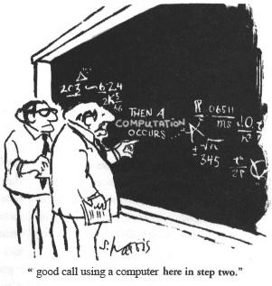
What is a programming language?
An artificial language with a limited purpose
A means of expressing computations (math) and algorithms (logic)

Slide 6
What is a programming language?
...like human languages in some ways!

Slide 7
Syntax (form)
Semantics (meaning)
signs/words (variables, symbols, numbers, strings)
expressions
"flow" (decisions, conditions, loops, narrative)
complex entities (methods, structures, & objects)

Slide 8
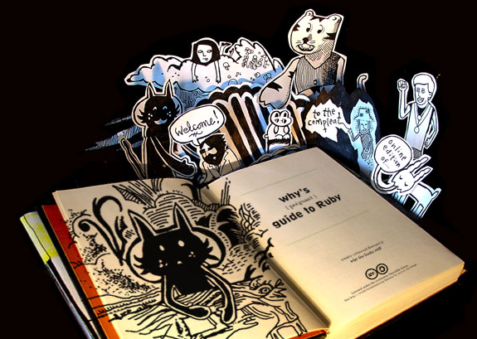
"when you don't create things, you become defined by your tastes rather than ability. your tastes only narrow & exclude people. so create.”
why the lucky stiff (@_why)
Notes:
Translation – get out there and try some stuff!

Slide 9
Language
Code used to create applications
Ruby
PHP
Python
JavaScript
Java
C++
C
many, many more...

Slide 10
Language Choice
Is it “easy” to maintain?
Is the standard library good enough?
What is it generally good for?
Can your team learn it?
Is your team using it?
Can you live with the syntax?
Do you hate it? Are you comfortable with it?

Slide 11
Library
A collection of reusable code to accomplish a generic activity
Date math (three months from today)
Logging
Working with file systems
Compressing files
Ex. - You don’t have to rewrite code to save a file to your drive each time because someone else did it for you!

Slide 12
Python
Python is a language
Libraries are called packages
Name is not a snake – it’s a Monty Python reference.
Notes:
Other things to add about it –
Syntax enforces good practices
Syntax matters
Good for doing things yourself
Flexible
legible
Difficult to manage installations sometimes

Slide 13
Python Philosophy:
Loaded into every Python installation as an easter egg:
>>> import this

Slide 14
Python Philosophy:
Beautiful is better than ugly.
Readability counts.
Errors should never pass silently. (JavaScript)
In the face of ambiguity, refuse the temptation to guess.
There should be one-- and preferably only one --obvious way to do it.
Now is better than never.

Slide 15
Python Philosophy: applied
Python is a humane interface (many ways to do things)
Favors readability and variety over concision and perfection
But it still has clear rules for what good style is
Sometimes this makes code harder to understand, but usually it’s easier
Contrasts with a minimal interface with one (or very few) “correct” ways to do things

Slide 16
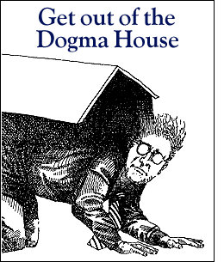
Dogma
Language x is not web-scale
Language x is not enterprise
Language x does not scale
The x framework doesn't handle this weird edge case

Slide 17
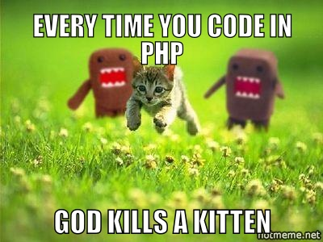

Slide 18
Why Python
General purpose
Usable on your computer or over the web
English-like syntax and useful built-in features
"Fun" to write
Syntax makes tabbing matter
Enforces good behaviors
Makes code very legible
Flexible
Implement things yourself
Good support
Notes:
Other things to add about it –
Syntax enforces good practices
Syntax matters
Good for doing things yourself
Flexible
legible
Difficult to manage installations sometimes

Slide 19
Why Not Python
Other languages can do some things better
R – better at stats and text analysis
Can do those things in Python, but might be slower or implementing from scratch
Difficult to manage package installations
Syntax matters
Forces you to have good behavior ☺
Not as easy to run on the web as PHP
Used less often than PHP, and major platforms (WordPress, Drupal, Omeka) use PHP
Notes:
Other things to add about it –
Syntax enforces good practices
Syntax matters
Good for doing things yourself
Flexible
legible
Difficult to manage installations sometimes

Slide 20
Two Pythons
Python 2.7
Python 3.3
Which to use? Complicated: 2 is more widely used, more third-party packages and not all port to 3.
3 is the present and future. Has better support for internationalization.
Mostly just need to know one the packages you’re using require. We’re using 3, but important to have both installed and know how to get between them.
Notes:
When programming, it’s not as easy as saying “oh we’ll just upgrade to the most recent version.

Slide 21
Two Pythons
Starting Python 2
$ python
Starting Python 3
$ python3
You can change this behavior – on my laptop I have those switched because I tend to use Python3 more.
Notes:
When programming, it’s not as easy as saying “oh we’ll just upgrade to the most recent version.

Slide 22
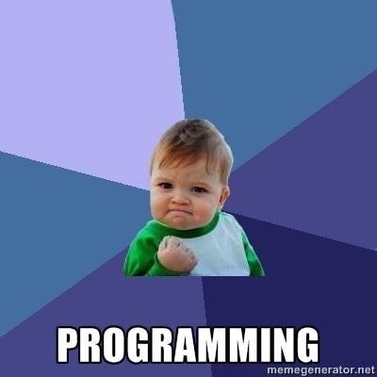
What we will cover
What is a data type?
What is a variable?
What is an operator?

Slide 23
What you will be able to do
create numeric and text information
store information in variables
print information to the screen

Slide 24
Open the Terminal
For us right now on VirtualBox:
Mint (Ubuntu): Terminal
Elsewhere:
Windows: git bash
OS X: iTerm2

Slide 25
Prompt
Terminals show a line of text after a command finishes
Whenever instructions start with "$ ", type the rest of the line into the terminal
Let's give the terminal a command to open Python 3.3 (python3)
$ python3

Slide 26
python3
Python has its own prompt that ends with >>>
$ python3
>>>
You can use Control + D to exit Python at any time or type exit() on its own line
When running Python in terminal, terminal commands won’t work

Slide 27
Variables
"words" that refer to information

Slide 28
Variables
Give it a name so we can refer to it
It's information can be changed
$ python3
>>> my_variable = 5
>>> print(my_variable)
5
>>> my_other_variable = "Hi“
>>> my_variable = 10
>>> my_other_variable
Hi
>>> my_variable
10

Slide 29
What's with = ?
Setting a variable to a value is called "assignment"
What types of information can we hold in a variable?

Slide 30
Variable Assignment
Variables are assigned using a single equals sign (=)
The right side of the equals sign is evaluated first, then assigned to the variable name on the left side of the equals

Slide 31
Variable Assignment
apples = 5
bananas = 10 + 5
fruits = 2 + apples + bananas
bananas = fruits – apples
Try printing bananas, apples, and fruits to the terminal before and after!

Slide 32
Variable Naming
all letters (folders)
all numbers (2000)
with an underscore (first_name)
with a dash (last-name)
a number anywhere (l33t)
a number at the start (101dalmations)
a number at the end (starwars2)
Notes:
Alternates good and bad possibilities

Slide 33
Variable Naming
Be descriptive of the “thing”
Notes:
Words generally are better. Someone reading your code should be able to tell what you’re talking about

Slide 34

Errors

Slide 35
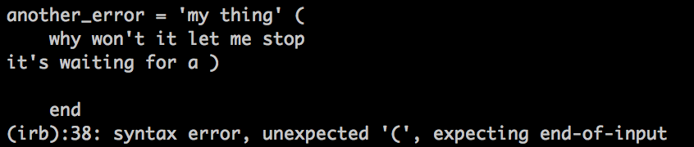
Errors cont.
If it doesn’t seem to be responding
you can always control + d

Slide 36
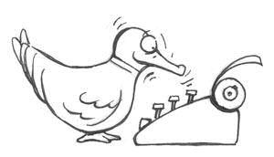
Ruby is a "duck-typed" language

Slide 37
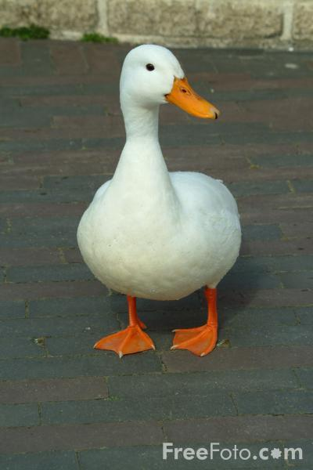
Duck-typing
If it looks like a duck and
it quacks like a duck,
chances are it's a duck.
Notes:
Means that the data types are not explicitly declared as such. We simply assume them to behave properly. And if they don’t they cause errors. So it’s a way of handling the declaration of variables.

Slide 38
Types of ducks
standard types:
numbers & letters
Notes:
characters and words (strings) sometimes two different things, depending on language

Slide 39
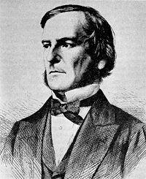
Numbers & Letters
integers:
4, 1040, -55, 9999
floating-point numbers:
1.1, 0.444, 9999.0001, -3.33
text (strings):
"a", 'cat', "The quick brown fox jumped over the lazy dogs.", '8 keys', '7'
boolean (yes or no?):
True, False, 0, 1
Notes:
characters and words (strings) sometimes two different things, depending on language

Slide 40
Strings
Strings are text; it must be wrapped in a matched pair of quotation marks.
$ python3
>>> 'Single quotes work'
‘Single quotes work’
>>> "Double quotes work"
‘Double quotes work’
>>> "Start and end have to match'
File “<stdin>”, line 1
“Start and end have to match’
^
SyntaxError: EOL while scanning string literal

Slide 41
Exercise
Create variables named first_name, last_name, and favorite_color
Assign string values to the variables

Slide 42
Numbers
Numbers without a decimal point are integers
0
-105
898989898
2
-898989898

Slide 43
Numbers
Numbers with decimal points are floating point numbers (floats)
0.0
-105.56
.33
.000004
3.14159265359

Slide 44
Numbers
You can perform operations on both types of numbers
+
-
/
*

Slide 45
Exercise
Try dividing an integer by an integer
Try dividing an integer by a float
Now do the same in Python 2.7
How are the results different?
Create two integer variables named num1 and num2 and assign your favorite numbers
Compute the sum, difference, quotient, and product of these two numbers and assign these values to variables named sum, difference, quotient, and product

Slide 46
An answer
num1 = 4
num2 = 5
sum = num1 + num2
difference = num1 - num2
quotient = num1 / num2
product = num1 * num2
If you try these in Python 2.7, why does quotient = 0 ?

Slide 47
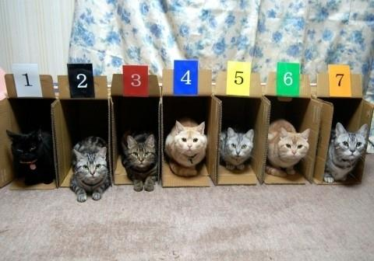
Collections
Notes:
Ways of organizing related groups of information to perform actions on them.

Slide 48
Collections
Collection Types: List, Dictionary
Define a list
List syntax
List indexing
List methods
Define a dict
Dict syntax
Dict indexing

Slide 49
List
A list is a collection of things
Each list is surrounded by square braces (aka square brackets) [ ]
Each item is separated by a comma
>>> fruits = ["kiwi", "strawberry", "plum"]
>>> fruits
[‘kiwi’, ‘strawberry’, ‘plum’]

Slide 50
Exercise
Make your own list named grocery_list
Include at least 5 items in your grocery list in the list

Slide 51
List
Indexing
Items are stored in order
Each item can be accessed by its index
Python starts counting at zero
>>> fruits[0]
‘kiwi’
>>> fruits[1]
‘strawberry’
>>> fruits[2]
‘plum’
Notes:
Why zero?
How many moves does it take to get to the next one.

Slide 52
Exercise
Still have your grocery_list list?
What is at index zero in your grocery list?
How about index 5?
Guess the answers and use the syntax examples to see if your guesses are correct
hint: fruits[0]

Slide 53
Dictionary
In a dict, we can associate an item with another value instead of just a number
Each item is a pair
Key: address of the dict member
Value: variable contained by the member, and located by the key name
Other names for a dictionary:
hash
associative array
map

Slide 54
Dict Syntax
Surrounded by curly braces (aka curly brackets) { }
Commas separate each member pair
A key uses : (a colon) to point to its value
>>> states = {"VA“: "Virginia", "MD“: "Maryland"}
>>> states
{"VA" => "Virginia", "MD" => "Maryland"}

Slide 55
Exercise
Define a dict named my_info that contains the following keys
first_name
last_name
hometown
favorite_food

Slide 56
Dict Indexing
Member pairs can be accessed by their key
Each key needs to be unique
Values do not need to be unique
Place key in brackets
>>> states["MD"]
‘Maryland’

Slide 57
Add A Key
For lists:
>>> instructors = [“Brandon”, “Ethan”]
>>> instructors.append(“Wayne”)
For dictionaries:
>>> my_info[“favorite_instructor”] = “Ethan”

Slide 58
Exercise
Add the key good_food to your my_info dict and give it the same value as your favorite_food key. What happens?
Add a second favorite_food key to your my_info dict. What happens?
Notes:
Keys are overwritten if you use a new one. They have to be unique.
Values on the other hand don’t have to be unique. Multiple keys can have the same value.

Slide 59
Methods
Things that do stuff
Objects (like strings, integers, and dictionaries) are nouns; methods are verbs
Called (used) with a "."
5.to_s (to_s is the method)
5 + 5 is a shortcut way of writing 5.+(5)
Each data type has a set of built in methods.
See String's methods https://docs.python.org/3/library/stdtypes.html#string-methods

Slide 60
Exercise
Create a String variable named old_string and assign it the value “Python is cool"
Use String methods to modify the old_string variable to that it is now “PYTHON IS COOL" and assign it to another variable named new_string
Hint: look at the String method "upper”

Slide 61
Booleans
A boolean can only have one of two values: True or False
>>> 1 + 1 == 2
True
>>> 1 + 1 == 0
False
(== means "is equal to;" More on that later...)

Slide 62
Exercise
Create a variable named favorite_color and assign it to your favorite color
Create a variable named not_favorite_color and assign it to a different color
Test if these variables are equal
Is equal to operator is ==

Slide 63
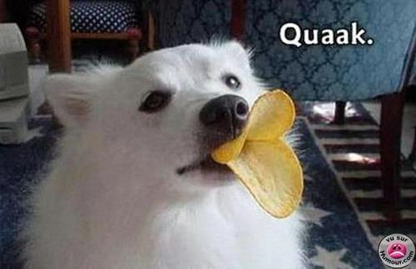
Sometimes there is a problem...
Notes:
With duck typed languages we assume that the variables we are using in particular places can do the things we want. Not always the case. Sometimes we need to change data types.

Slide 64
Casting to appropriate type
to_s (to string)
to_i (to integer)
to_f (guesses?)
Example:
> "3".to_f
=> 3.0

Slide 65
Operators: do stuff with objects
>>> my_variable + 2
7
>>> my_variable * 3
15
>>> my_other_variable + " there!" "hi there!"
>>> fruits = fruits + ["lychee"]
["kiwi", "strawberry", "plum", "lychee"]
>>> fruits.remove("lychee“)
["kiwi", "strawberry", "plum"]
Notes:
"Doing stuff" usually doesn't change the variables used. You'd need to use write things like
new_variable = my_variable + 2
or
my_variable = my_variable + 2
to use this value later.

Slide 66
Exercises
Create a list named vegetables that contain three vegetables you like and one vegetable you don't
Using the vegetables list, create a list named my_vegetables that contains only the vegetables you like
Extra: can you use the first two lists to create a new array named your_vegetables that only contains the vegetables you don't like?
Notes:
Extra – your_vegetables = vegetables – my_vegetables

Slide 67
Spacing and Legibility
vegetables = ['here', 'are', 'my', 'vegetables']
Vs.
vegetables=['here’, 'are’,'my', 'vegetables']
Keep things regular and neat.

Slide 68
More Operators
+, -, /, * math operators (+ also means concatenation)
= assign a value
+= addition, then assignment (x += y vs. x = x + y)
** exponent
== equal
!= not equal
For more operators: https://www.tutorialspoint.com/python/python_basic_operators.htm

Slide 69
Printing things to the screen
>>> print("Doctor Who“)
>>> doctors = ['Matt Smith', 'David Tennent']
>>> print(doctors[0])
>>> best_episode = 'Blink'
>>> print("My favorite episode is " + best_episode)
>>> print("My favorite Doctor is " + doctors[1])

Slide 70
Code Exercise 1
Store your street address, city, state, and zip code in variables (or even better, a dictionary!), then print them in the usual format:
Brandon Walsh
123 My Street
Charlottesville, VA 22903

Slide 71
An Answer
address = {
'name‘: ‘Ethan Reed',
'street‘: '123 My Street',
'city‘: Charlottesville',
'state‘: 'VA',
'zip‘: ‘22903'
}
print(address['name'])
print(address['street'])
print(address['city'] + ', ' + address['state'] + ' ' + address['zip'])
Notes:
Other options?

Slide 72
Code Exercise 1
Write a program that converts seconds to years. Test your program with 600000000 seconds, 60 seconds, and 40000.33 seconds.

Slide 73
An Approach
Figure out how many seconds in a year
60 seconds in a minute
60 minutes in an hour
24 hours in a day
365 days in a year (365.242 if you're really precise)
Do the math
Return a result

Slide 74
An Answer
sec = 600000000.0
print(sec/60/60/24/365)

Slide 75
Resources
Rubylearning.com
Learn to Program (http://pine.fm/LearnToProgram/)
Why's Poignant Guide to Ruby (http://mislav.uniqpath.com/poignant-guide/)
Ruby Documentation (http://ruby-doc.org/core/)
"Pick-axe Book" (http://ruby-doc.org/docs/ProgrammingRuby/)

